Slide 1


TITLE: GROCERY STORE MANAGEMENT SQL PROJECT

Slide 2
About Me:
My name is Katchayani, and I have completed my Bachelor of Computer Applications (BCA). I am interested in becoming a Data Analyst and enjoy working with data to find useful insights. I am passionate about learning new tools and improving my analytical skills.
I have completed my BCA, which helped me build a strong foundation in computers and data-related concepts. I am interested in a Data Analyst role because I like working with data, analyzing patterns, and using data to make better decisions. I am a fresher and currently building my skills through projects and learning tools like SQL and Power BI.
I have completed a SQL-based project on grocery store data analysis, where I analyzed customer orders, product sales, and revenue trends to understand business performance.
LinkedIn :https://www.linkedin.com/in/katchayani-borra-853780301

Slide 3
Project overview:
Project Name: Grocery Management
System Tool: MySQL workbench
Goal: Analyze sales, customers, products

Slide 4
Agenda:
Objectives of the Project
ER Diagram and schema explanation
Key analysis questions (USE CASES)
SQL query results with summaries
Final Business
Insights Conclusion

Slide 5
Objectives:
To design and implement a relational database for a grocery store.
To retrieve and manipulate data using SQL queries.
To perform data analysis for business insights such as top customers, best-selling products, and revenue trends.
To practice using joins, aggregations, subqueries, and filtering techniques.

Slide 6
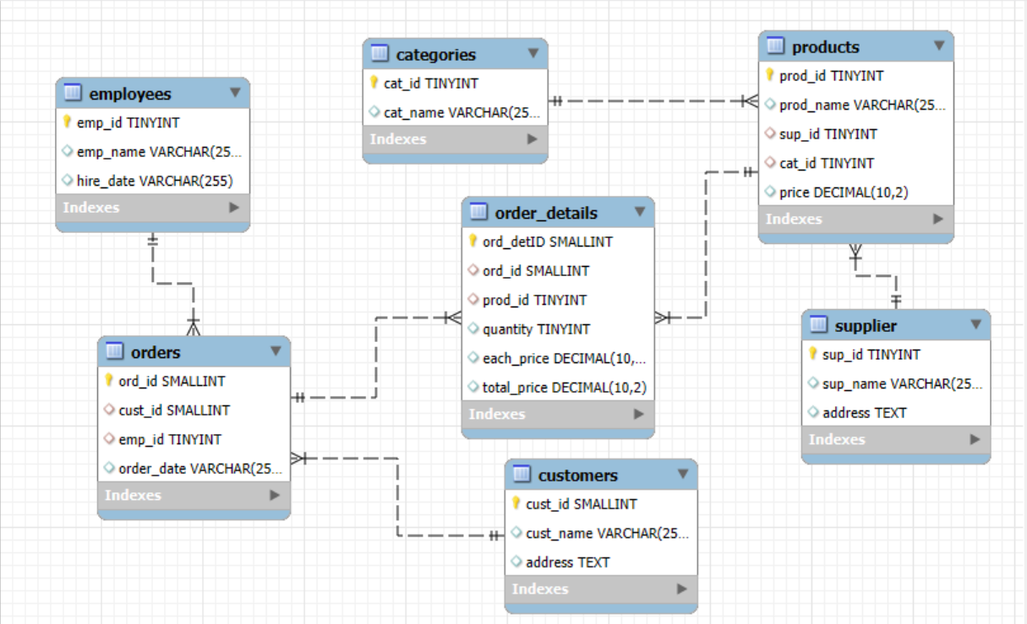
ER DIAGRAM
One-to-Many from supplier to products
One-to-Many from categories to products
One-to-Many from products to
order-details
One-to-Many from orders to order-details
One-to-Many from customers to orders
One-to-Many from employees to orders

Slide 7

Business Questions:
Who are top customers?
Which products sell more?
What is total sales?
Which employee performs best?
Sales trends over time ?

Slide 8

SQL APPROACH:
HOW I SOLVED:
Used JOINS (combine tables)
Used GROUP BY (aggregation)
Used SUM, AVG, COUNT
Used date functions

Slide 9
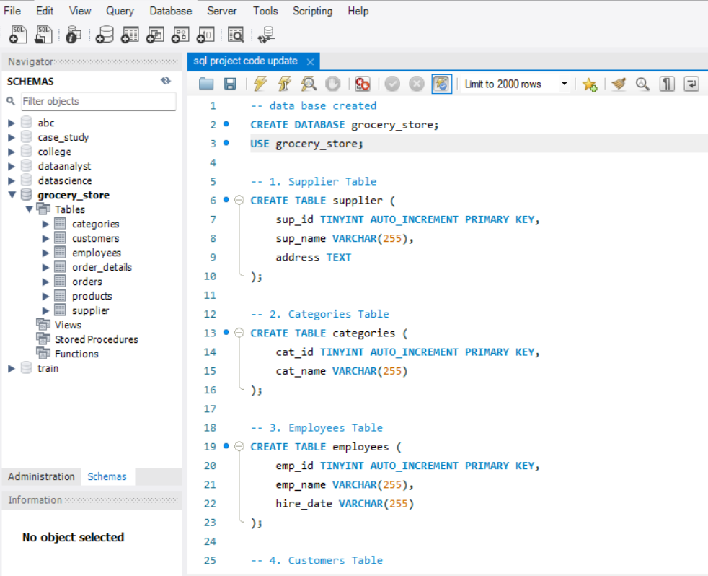
Data base /Tables:
Database : Grocery-store
Tables :
Customers
Orders
Order-Details
Products
Supplier
Employees
Categories

Slide 10


ANALYSIS & INSIGHTS:

Slide 11
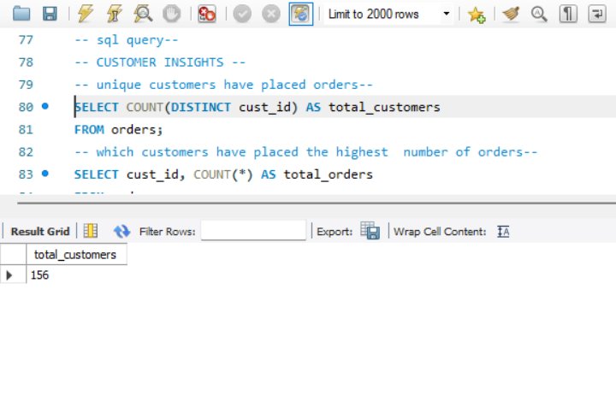
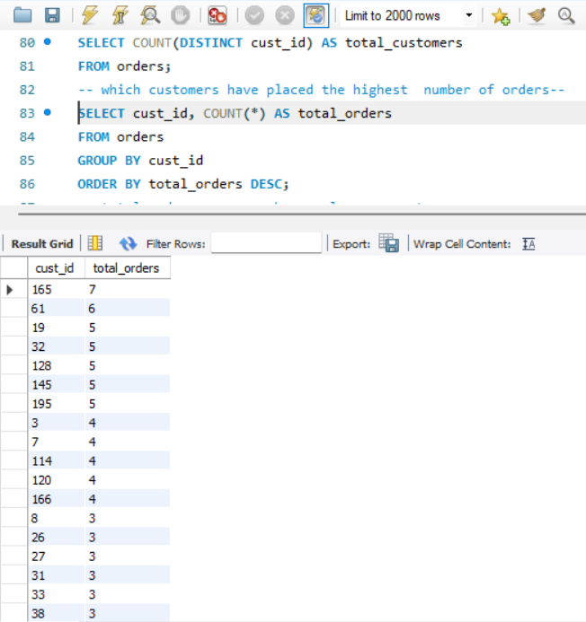
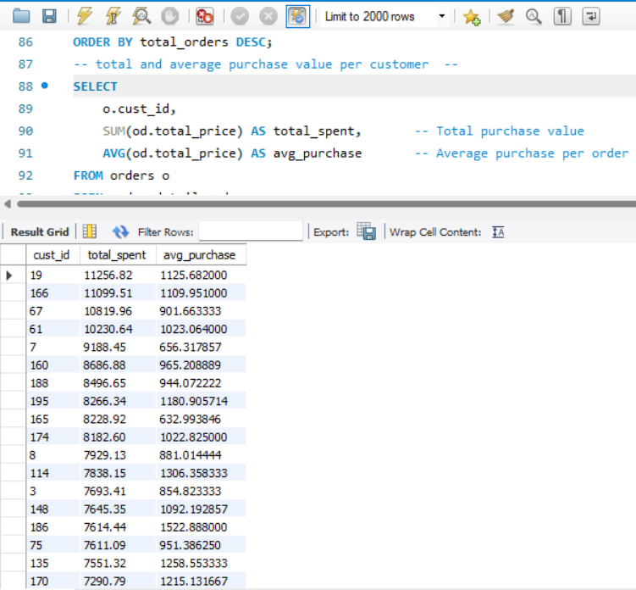
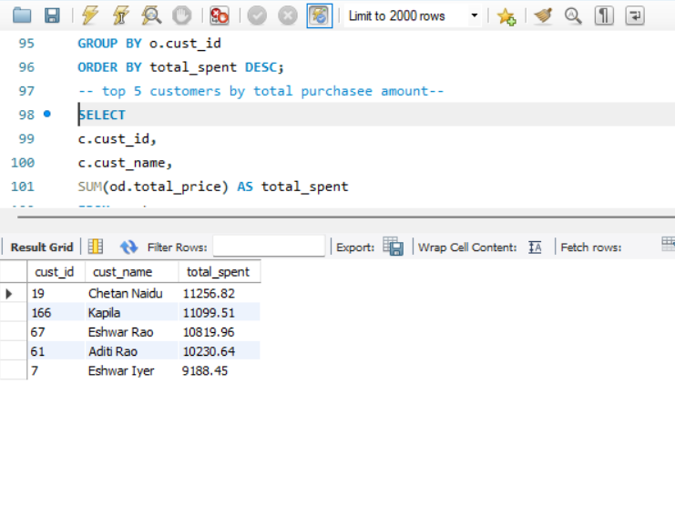
Customer Insights:
Gain an understanding of customer engagement and purchasing behavior.
How many unique customers have placed orders?
Which customers have placed the highest number of orders?
What is the total and average purchase value per customer?
Who are the top 5 customers by total purchase amount?

Slide 12
Q1) How many unique customers have placed orders?
Answer: This shows the total number of different customers who placed orders.
It helps to understand customer reach.
Real-Life Insight : More unique customers means better business growth and wider audience

Slide 13
Q2) Which customers have placed the highest number of orders?
Answer: Customers are ranked based on how many orders they placed.
Top customers order frequently.
Real-Life Insight : Frequent customers are loyal. Business can target them with rewards or offers

Slide 14
Q3) What is the total and average purchase value per customer?
Answer: Total shows how much a customer spent overall .
Average shows spending per order.
Real-Life Insight : Helps identify high-value customers.
Useful for personalized marketing.

Slide 15
Q4) Who are the top 5 customers by total purchase amount?
Answer : Top 5 customers are identified based on highest spending.
They contribute the most revenue .
Real-Life Insight :These customers are very important for business .
They should be retained with special benefits.

Slide 16
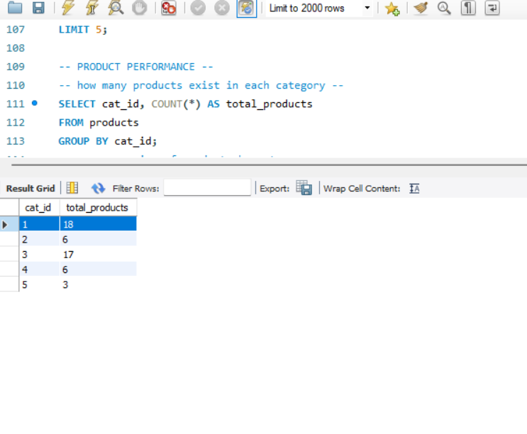
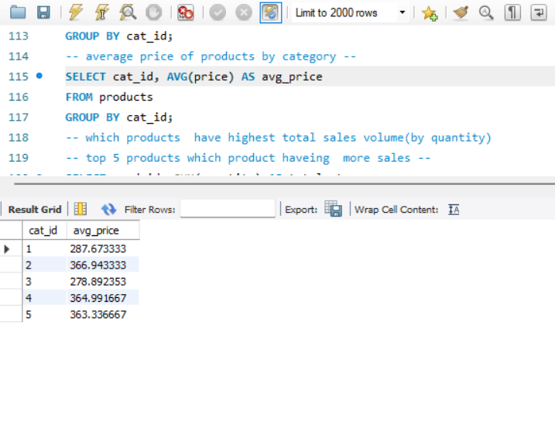
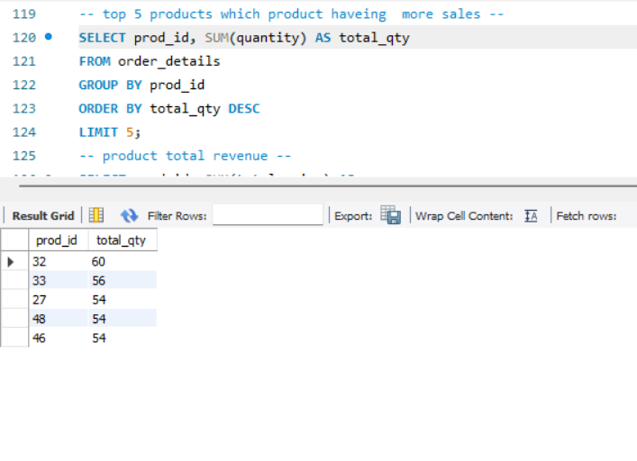
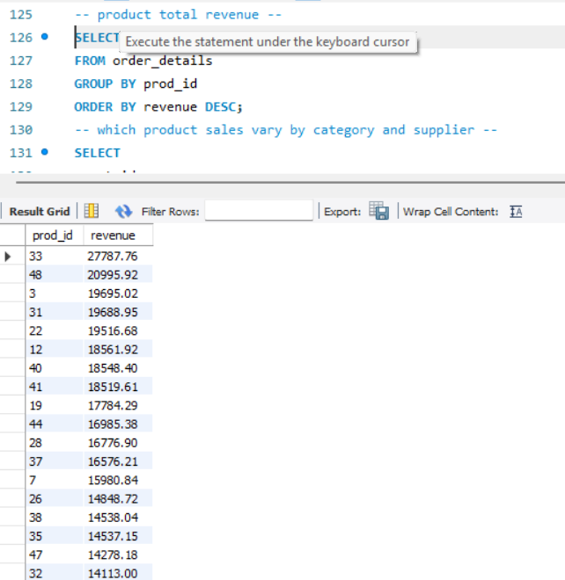
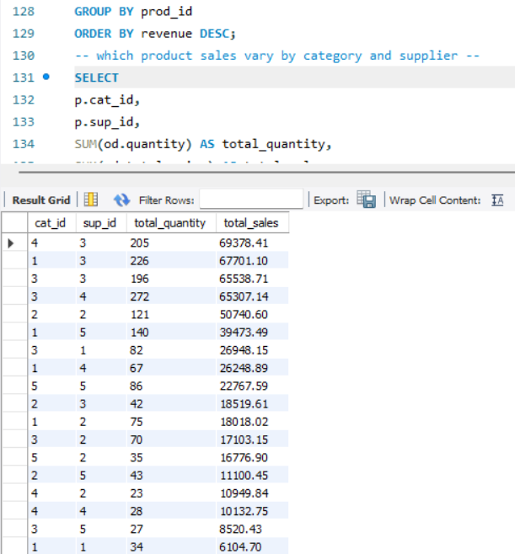
Product Performance:
Evaluate how well products are performing in terms of sales and revenue.
How many products exist in each category?
What is the average price of products by category?
Which products have the highest total sales volume (by quantity)?
What is the total revenue generated by each product?
How do product sales vary by category and supplier?

Slide 17
Q1) How many products exist in each category ?
Answer: This shows the number of products in each category .
Real-Life Insight : Helps understand product distribution .
Business can balance categories properly.

Slide 18
Q2) What is the average price of products by category?
Answer: This shows the average cost of products in each category.
Real-Life Insight : Helps identify expensive and affordable categories.
Useful for pricing strategy

Slide 19
Q3) Which products have the highest total sales volume?
Answer: Products are ranked based on total quantity sold .
Real-Life Insight : High-demand products should always be in stock.
They drive regular sales.

Slide 20
Q4) What is the total revenue generated by each product?
Answer: Shows how much money each product generated.
Real-Life Insight: Helps identify most profitable products.
Focus more on high-revenue items.

Slide 21
Q5) How do product sales vary by category and supplier?
Answer: Sales are grouped by category and supplier combination.
Real-Life Insight : Helps find which supplier-category performs best .
Useful for business partnerships.

Slide 22
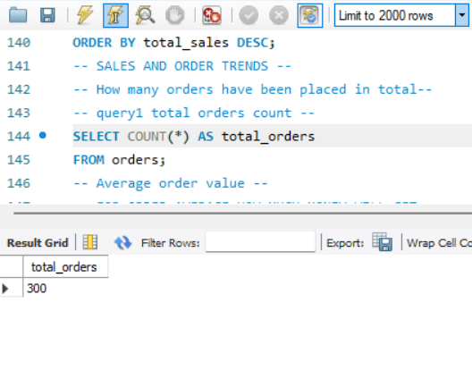
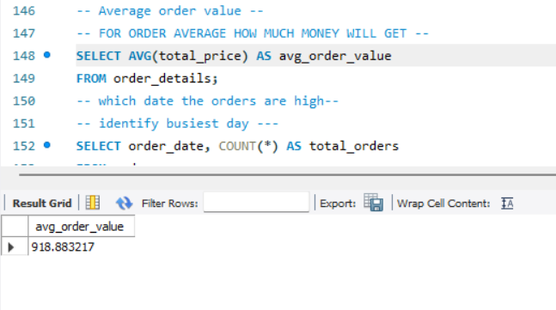
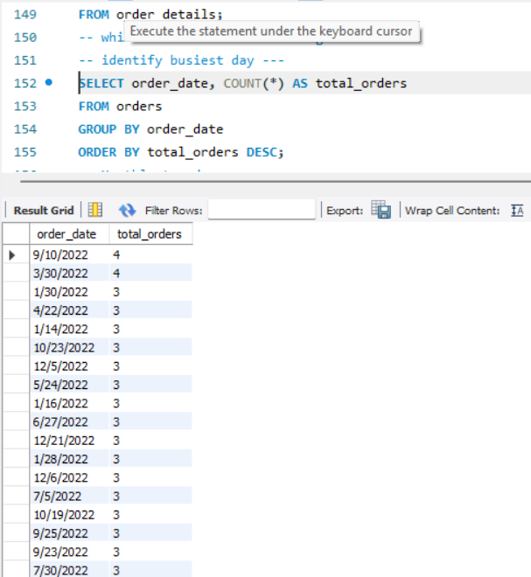
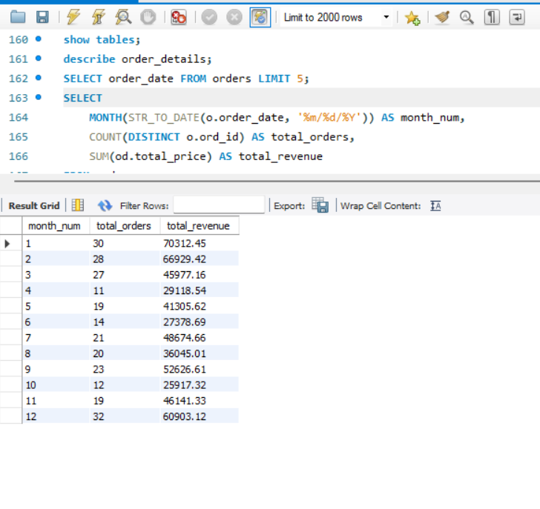
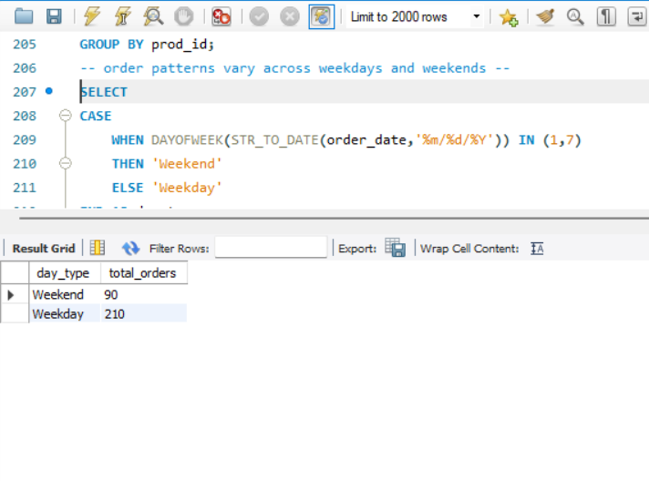
Sales and Order Trends:
Analyze business performance through orders and revenue over time.
How many orders have been placed in total?
What is the average value per order?
On which dates were the most orders placed?
What are the monthly trends in order volume and revenue?
How do order patterns vary across weekdays and weekends?

Slide 23
Q1) How many orders have been placed in total ?
Answer : Counts total number of orders in the system.
Real-Life Insight : Shows overall business activity level.

Slide 24
Q2) What is the average value per order?
Answer : Shows average money spent per order.
Real-Life Insight : Higher average means customers are buying more items.

Slide 25
Q3) On which dates were the most orders placed?
Answer: Identifies days with highest number of orders.
Real-Life Insight : Helps plan offers during peak days.

Slide 26
Q4) What are the monthly trends in order volume and revenue?
Answer : Shows how orders and revenue change month by month.
Real-Life Insight :Helps identify seasonal trends.
Business can plan stock and marketing.

Slide 27
Q5) How do order patterns vary across weekdays and weekends?
Answer: Orders are grouped into weekday and weekend .
Real-Life Insight : Helps understand customer buying behavior .
Weekend offers can increase sales.

Slide 28
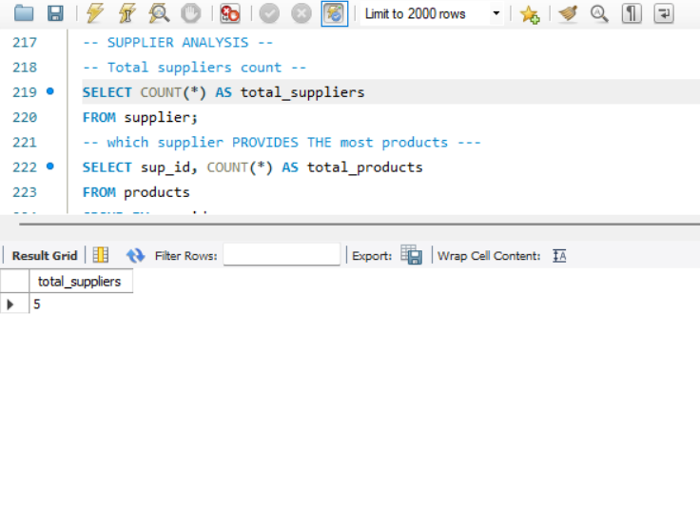
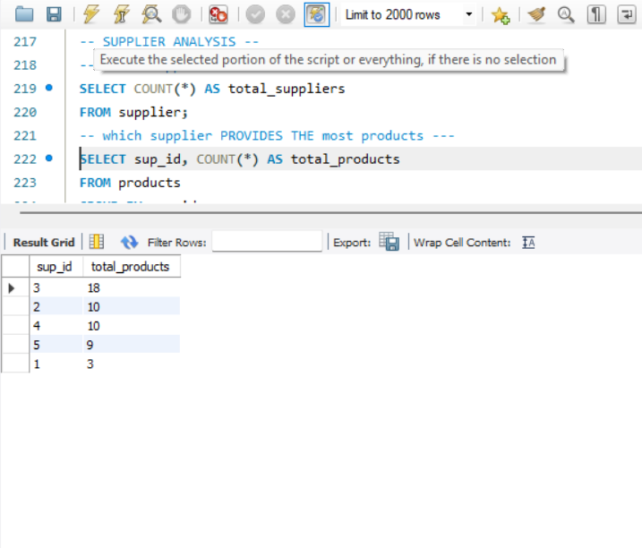
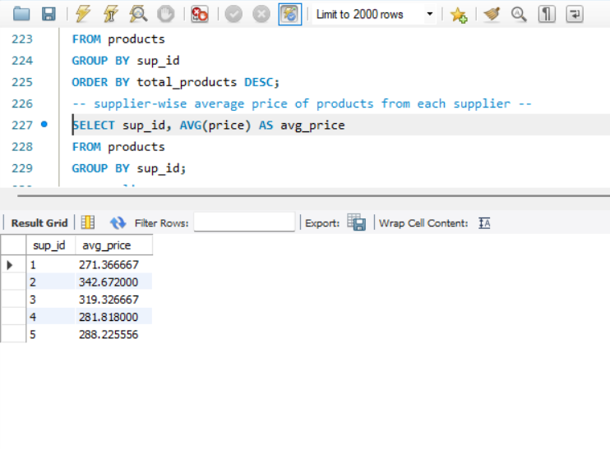
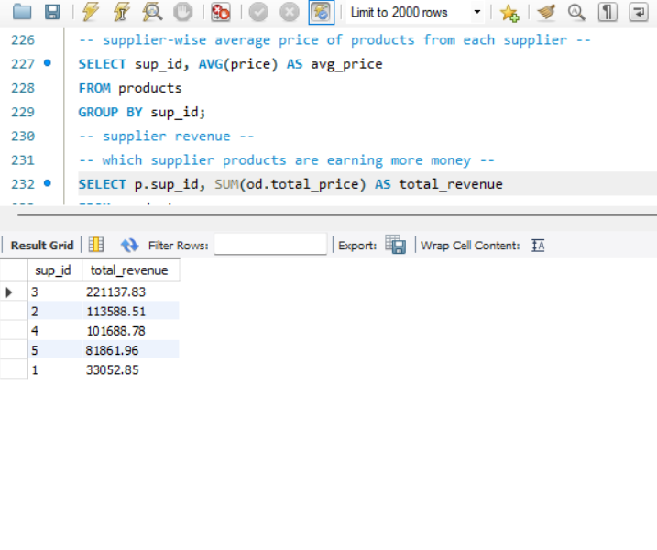
Supplier Contribution:
Identify the most active and profitable suppliers.
How many suppliers are there in the database?
Which supplier provides the most products?
What is the average price of products from each supplier?
Which suppliers contribute the most to total product sales (by revenue)?

Slide 29
Q1) How many suppliers are there?
Answer: Counts total number of suppliers.
Real-Life Insight : More suppliers give more product variety.

Slide 30
Q2) Which supplier provides the most products?
Answer : Supplier with highest number of products is identified.
Real-Life Insight : Important supplier for inventory.

Slide 31
Q3) What is the average price of products from each supplier?
Answer : Shows average product price per supplier.
Real-Life Insight :Helps compare supplier pricing.

Slide 32
Q4) Which suppliers contribute the most revenue?
Answer: Suppliers are ranked by total sales value.
Real-Life Insight : Top suppliers are key business partners

Slide 33
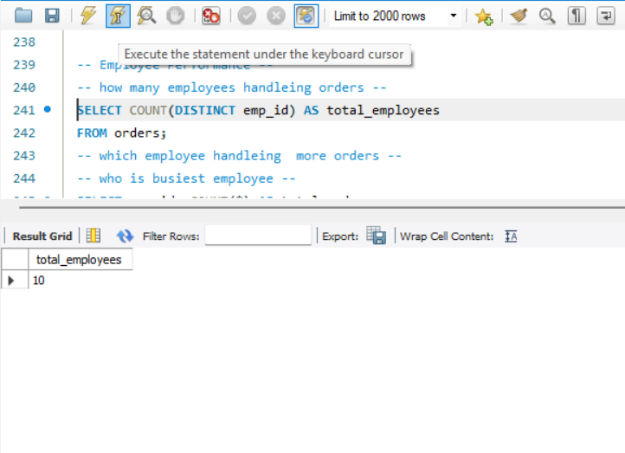
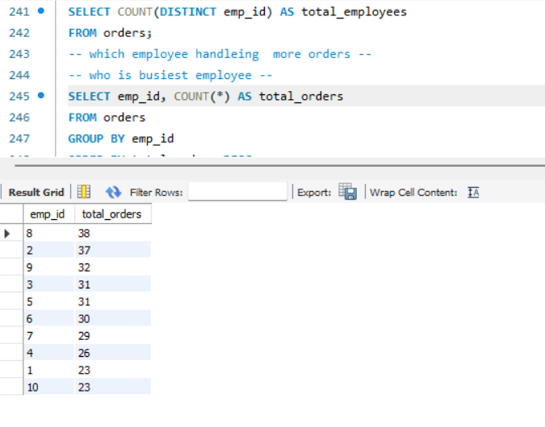
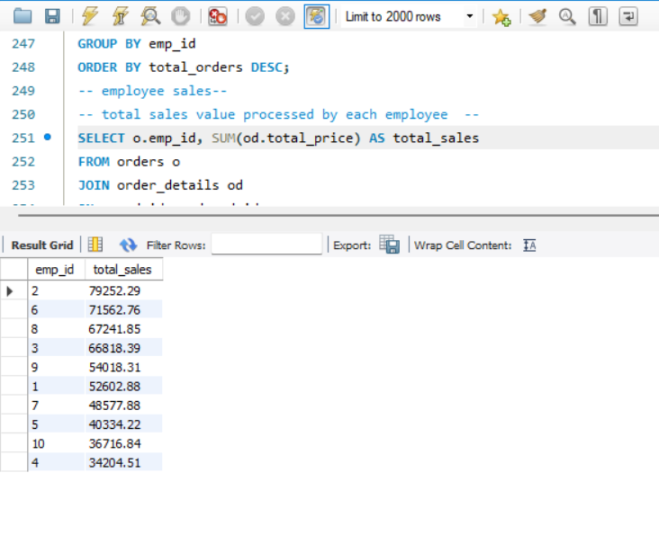
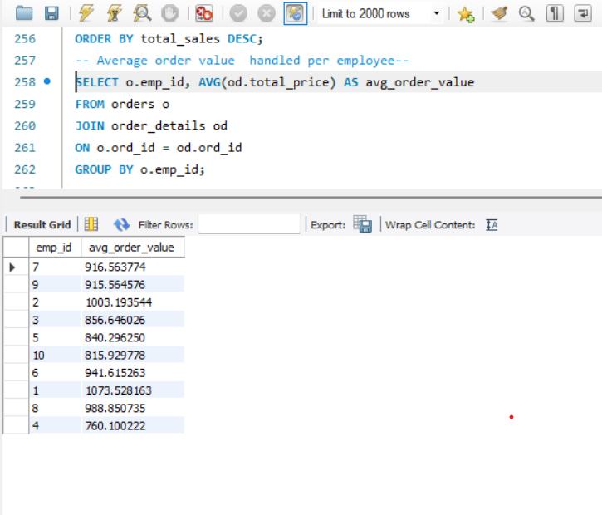
Employee Performance:
Assess how employees are handling and influencing sales.
How many employees have processed orders?
Which employees have handled the most orders?
What is the total sales value processed by each employee?
What is the average order value handled per employee?

Slide 34
Q1) How many employees processed orders?
Answer: Counts employees who handled orders.
Real-Life Insight : Shows workforce involvement

Slide 35
Q2) Which employees handled the most orders?
Answer: Employees ranked by number of orders handled.
Real-Life Insight :Top performers can be rewarded.

Slide 36
Q3) What is the total sales handled by each employee?
Answer: Shows sales value handled per employee.
Real-Life Insight : Helps measure employee contribution.

Slide 37
Q4) What is the average order value per employee?
Answer: Shows average value of orders handled.
Real-Life Insight : Indicates efficiency of employees.

Slide 38
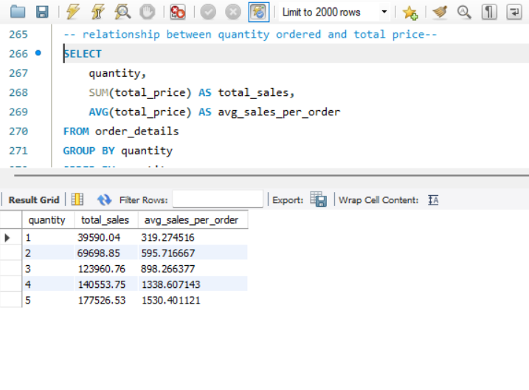
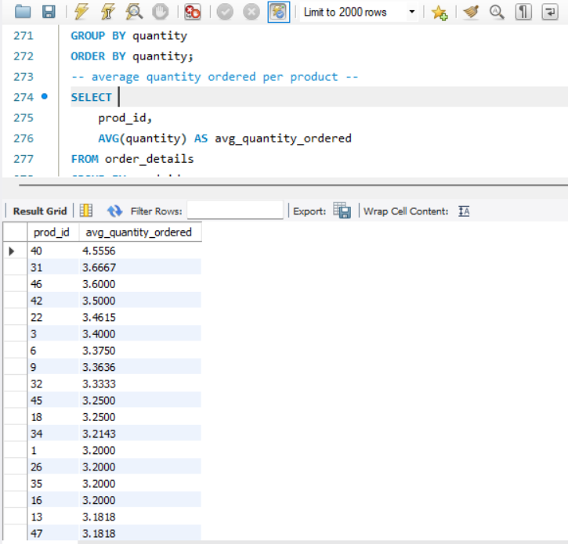
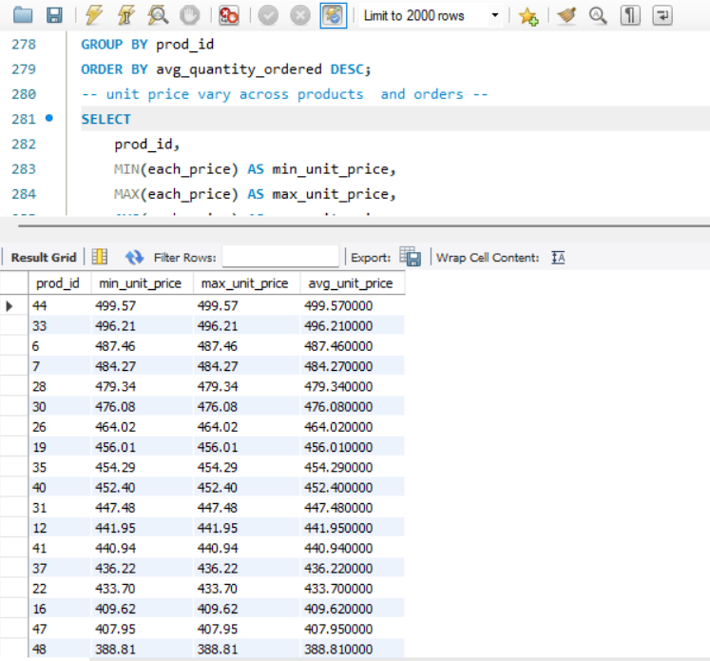
Order details deep drive:
Explore item-level sale patterns and pricing behavior.
What is the relationship between quantity ordered and total price?
What is the average quantity ordered per product?
How does the unit price vary across products and orders?

Slide 39
Q1) What is the relationship between quantity and total price?
Answer: Shows how total price changes with quantity .
Real-Life Insight : Higher quantity usually increases total sales.

Slide 40
Q2) What is the average quantity ordered per product?
Answer: Shows average number of items ordered per product .
Real-Life Insight : Helps identify popular products.

Slide 41
Q3) How does the unit price vary across products and orders?
Answer: Shows minimum, maximum, and average price.
Real-Life Insight : Helps understand pricing differences.

Slide 42
FINAL BUSINESS INSIGHTS :
Key Insights :
A major portion of revenue comes from a small group of high-value customers .
Some products consistently generate higher sales and revenue compared to others .
Sales performance varies across different categories and suppliers.
Order patterns show clear variation across specific days and months.
Employee contribution is not equal, with some employees handling more orders and sales.
Insight Summary : These patterns highlight key areas that drive business performance and growth.

Slide 43
Business Recommendations :
Recommendations:
Retain high-value customers through personalized offers and loyalty programs.
Maintain proper stock levels for high-demand products.
Improve low-performing categories using promotions and better pricing strategies.
Build strong relationships with top-performing suppliers .
Plan marketing campaigns during peak sales periods.
Provide training and support to improve employee performance.
Recommendation Summary: Applying these strategies can help increase sales, improve efficiency, and boost overall profitability.

Slide 44
CONCLUSION :
This project analyzes customer orders, product sales, and revenue in a grocery store database.
It helps us understand which products sell more and how customers place orders.
The monthly analysis shows how sales and revenue change over time.
By using this data, the business can:
Improve sales in low months
Manage stock in high-demand months
Focus on products that perform well
Overall, this analysis helps the business make better decisions and increase profit.

Slide 45
Experiences & Challenges:
Understanding table relationships and applying correct joins.
Ensuring data consistency with foreign key constraints.
Handling aggregation across joined tables.
Extracting time-based trends from date data (especially if in VARCHAR format).

Slide 46


Slide 47

THANK YOU

